Slide 1

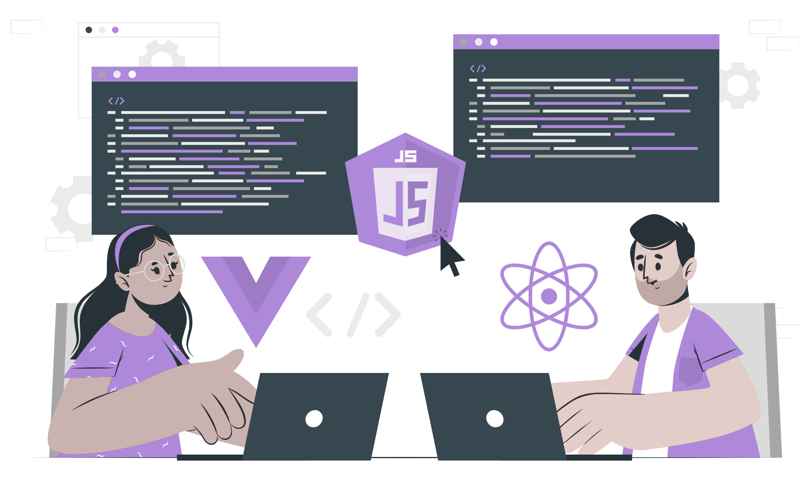
NodeJS Architecture

Slide 2
List of content:
Architecture of nodeJS
Working of nodeJS
Components of nodeJS
Advantages

Slide 3
Node Js

Slide 4
How does single-thread work?

Slide 5
Why does Node.js use “Single-threaded event loop model” architecture?

Slide 6
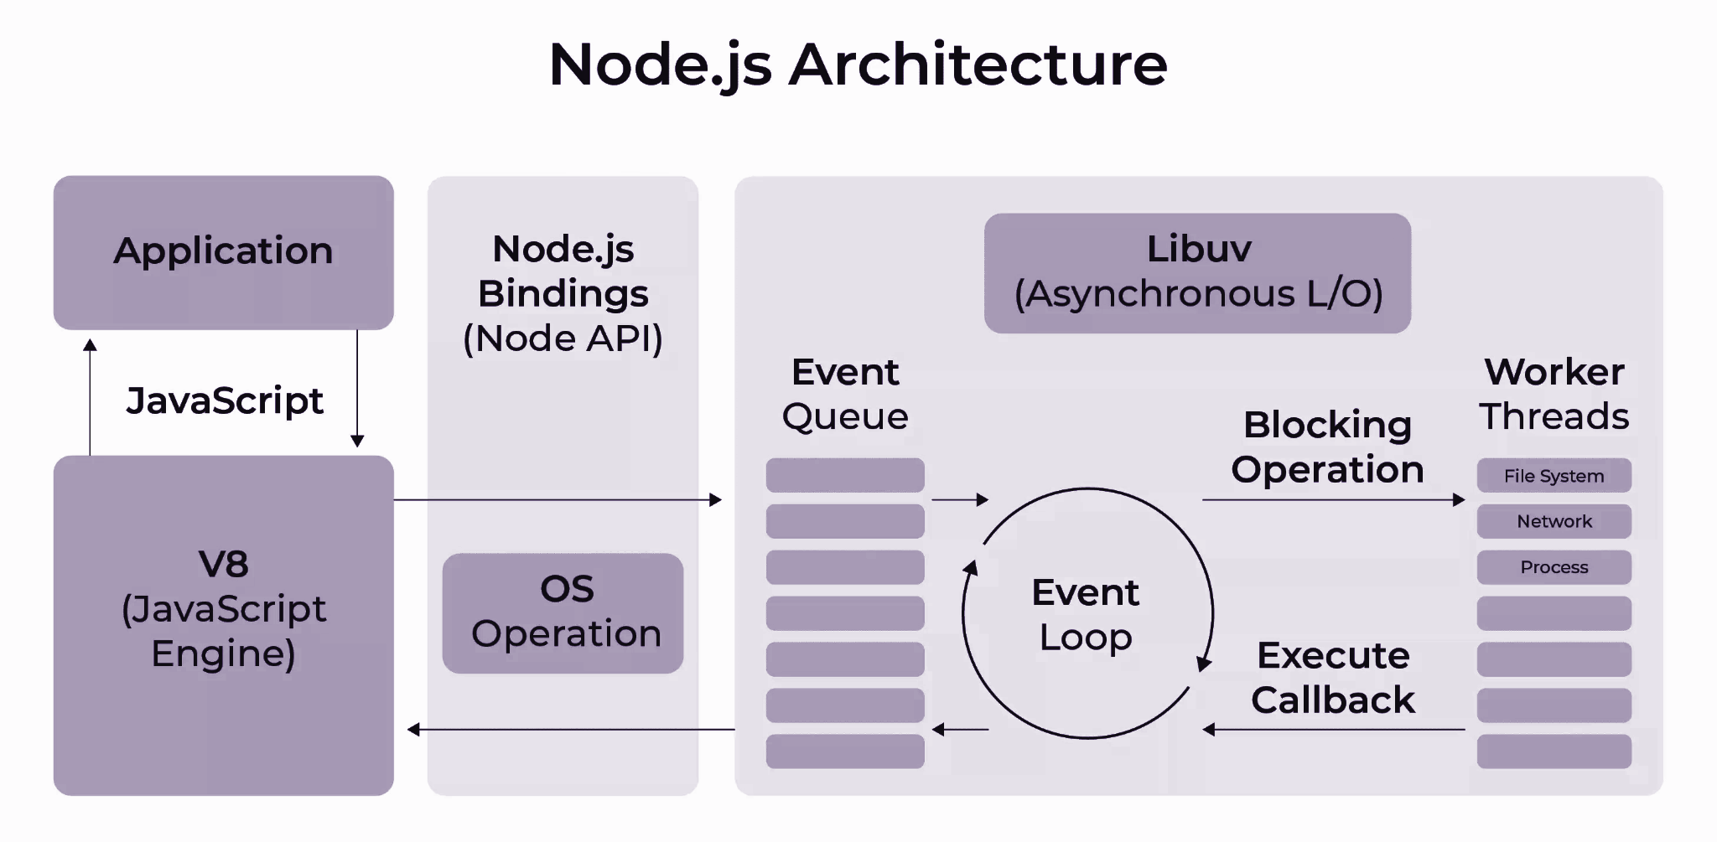
Architecture
The architecture of Node.js comprises two main concepts: an Asynchronous model that resembles the event-based approach of JavaScript, and Non-blocking I/O operations.

Slide 7
Components :
Node.js architecture consists of several components that work together to handle incoming client requests and process responses. These components are:
Requests
Node.js Server.
Event Queue
Event Loop.
Thread Pool.
External Resources

Slide 8
Working :
Incoming client requests are received by Node.js, which can be either simple (non-blocking) or complex (blocking), depending on the task to be performed.
Querying for specific data involves searching for particular data in a database.
Deleting data involves sending a request to delete specific data or performing a deleting query.
Updating data involves sending a request to change or update a set of data or performing an updating query on a particular row of tables to update a specific entry in the database.
Node.js adds incoming client requests to its event queue.
The event loop in Node.js processes the requests one by one and checks whether external resources are required. If so, the requests are allocated with external resources; otherwise, they move on to the next step.
Non-blocking (simple) requests are processed in the event loop, such as I/O polling, and responses are returned to the respective clients.

Slide 9
Advantages of NodeJS:
Its asynchronous model and non-blocking I/O operation improve the scalability and performance of web applications built on other frameworks.
Node js can easily handle multiple client requests without requiring multiple threads, consuming less memory and resources. Additionally, it is highly scalable and provides high performance.
Node js is also flexible with multiple frameworks and makes the development process easier.

Slide 10
THANK YOU

